Slide 1
Attacks on collaborative recommender systems

Slide 2
Agenda
Introduction
Charactarization of Attacks
Attack models
Effectivness analysis
Countermeasures
Privacy aspects
Discussion

Slide 3
Introduction / Background
(Monetary) value of being in recommendation lists
Individuals may be interested to push some items by manipulating the recommender system
Individuals might be interested to decrease the rank of other items
Some simply might may want to sabotage the system ..
Manipulation of the "Internet opinion"
Malevolent users try to influence behavior of recommender systems
System should include a certain item very often/seldom in its recommendation list
A simple strategy?
(Automatically) create numerous fake accounts / profiles
Issue high or low ratings to the "target item"
Will not work for neighbor-based recommenders
More elaborate attack models required
Goal is to insert profiles that will appear in neighborhood of many

Slide 4
Example profile injection
Assume that a memory-based collaborative filtering is used with:
Pearson correlation as similarity measure
Neighborhood size of 1
Only opinion of most similar user will be used to make prediction
 | Item1 | Item2 | Item3 | Item4 | … | Target | Pearson
Alice | 5 | 3 | 4 | 1 | … | ?
User1 | 3 | 1 | 2 | 5 | … | 5 | -0.54
User2 | 4 | 3 | 3 | 3 | … | 2 | 0.68
User3 | 3 | 3 | 1 | 5 | … | 4 | -0.72
User4 | 1 | 5 | 5 | 2 | … | 1 | -0.02

Slide 5
Example profile injection
Assume that a memory-based collaborative filtering is used with:
Pearson correlation as similarity measure
Neighborhood size of 1
Only opinion of most similar user will be used to make prediction
 | Item1 | Item2 | Item3 | Item4 | … | Target | Pearson
Alice | 5 | 3 | 4 | 1 | … | ?
User1 | 3 | 1 | 2 | 5 | … | 5 | -0.54
User2 | 4 | 3 | 3 | 3 | … | 2 | 0.68
User3 | 3 | 3 | 1 | 5 | … | 4 | -0.72
User4 | 1 | 5 | 5 | 2 | … | 1 | -0.02
User2 most similar to Alice

Slide 6

Example profile injection
Assume that a memory-based collaborative filtering is used with:
Pearson correlation as similarity measure
Neighborhood size of 1
Only opinion of most similar user will be used to make prediction
 | Item1 | Item2 | Item3 | Item4 | … | Target | Pearson
Alice | 5 | 3 | 4 | 1 | … | ?
User1 | 3 | 1 | 2 | 5 | … | 5 | -0.54
User2 | 4 | 3 | 3 | 3 | … | 2 | 0.68
User3 | 3 | 3 | 1 | 5 | … | 4 | -0.72
User4 | 1 | 5 | 5 | 2 | … | 1 | -0.02
Attack | 5 | 3 | 4 | 3 | … | 5 | 0.87
User2 most similar to Alice
Attack

Slide 7
Example profile injection
Assume that a memory-based collaborative filtering is used with:
Pearson correlation as similarity measure
Neighborhood size of 1
Only opinion of most similar user will be used to make prediction
 | Item1 | Item2 | Item3 | Item4 | … | Target | Pearson
Alice | 5 | 3 | 4 | 1 | … | ?
User1 | 3 | 1 | 2 | 5 | … | 5 | -0.54
User2 | 4 | 3 | 3 | 3 | … | 2 | 0.68
User3 | 3 | 3 | 1 | 5 | … | 4 | -0.72
User4 | 1 | 5 | 5 | 2 | … | 1 | -0.02
Attack | 5 | 3 | 4 | 3 | … | 5 | 0.87
User2 most similar to Alice
Attack
Attack most similar to Alice

Slide 8
Characterization of profile insertion attacks
Attack dimensions
Push attack:
Increase the prediction value of a target item
Nuke attack:
Decrease the prediction value of a target item
Make the recommender system unusable as a whole
No technical difference between push and nuke attacks
Nevertheless Push and Nuke attacks are not always equally effective
Another differentiation factor between attacks:
Where is the focus of an attack? Only on particular users and items?
Targeting a subset of items or users might be less suspicious
More focused attacks may be more effective (attack profile more precisely defined)

Slide 9
Characterization of profile insertion attacks
Classification criteria for recommender system attacks include:
Cost
How costly is it to make an attack?
How many profiles have to be inserted?
Is knowledge about the ratings matrix required?
usually it is not public, but estimates can be made
Algorithm dependability
Is the attack designed for a particular recommendation algorithm?
Detectability
How easy is it to detect the attack

Slide 10
The Random Attack
General scheme of an attack profile
Attack models mainly differ in the way the profile sections are filled
Random attack model
Take random values for filler items
Typical distribution of ratings is known, e.g., for the movie domain (Average 3.6, standard deviation around 1.1)
Idea:
generate profiles with "typical" ratings so they are considered as neighbors to many other real profiles
High/low ratings for target items
Limited effect compared with more advanced models
Item1 | … | ItemK | … | ItemL | … | ItemN | Target
r_1 | … | r_k | … | r_l | … | r_n | X
selected items |  |  | filler items |  | unrated items

Slide 11
The Average Attack
use the individual item's rating average for the filler items
intuitively, there should be more neighbors
additional cost involved: find out the average rating of an item
more effective than Random Attack in user-based CF
But additional knowledge is required
Quite easy to determine average rating values per item
Values explicitly provided when item is displayed

Slide 12
Effectiveness
By the way: what does effective mean?
Possible metrics to measure the introduced bias
Robustness
deviation in general accuracy of algorithm
Stability
change in prediction for a target item (before/after attack)
In addition: rank metrics
How often does an item appear in Top-N lists (before/after)

Slide 13
Bandwagon Attack
Exploits additional information about the community ratings
Simple idea:
Add profiles that contain high ratings for "blockbusters" (in the selected items); use random values for the filler items
Will intuitively lead to more neighbors because
popular items will have many ratings and
rating values are similar to many other user-profiles
Example: Injecting a profile with high rating values for the Harry Potter series
Low-cost attack
Set of top-selling items/blockbusters can be easily determined
Does not require additional knowledge about mean item ratings

Slide 14
Segment Attack
Designing an attack that aims to push item A
Find items that are similar to target item,
These items probably liked by the same group of people
Identify subset of user community that is interested in items similar to A
Inject profiles that have
high ratings for fantasy novels and
random or low ratings for other genres
Thus, item will be pushed within the relevant community
For example: Push the new Harry Potter book
Attacker will inject profile with positive ratings for other popular fantasy books
Harry Potter book will be recommended to typical fantasy book reader
Additional knowledge (e.g. genre of a book) is required

Slide 15
Special nuke attacks
Love/hate attack
Target item is given the minimum value
Filler items are given the highest possible rating value
Serious effect on system’s recommendations when goal is to nuke an item
Other way around (push an item) it is not effective
Reverse bandwagon
Associate target item with other items that are disliked by many people.
Selected item set is filled with minimum ratings

Slide 16
Effectiveness analysis
Effect depends mainly on the attack size (number of fake profiles inserted)
User-based recommenders:
Bandwagon / Average Attack:
Bias shift of 1.5 points on a 5-point scale at 3% attack size
Average Attack slightly better but requires more knowledge
1.5 points shift is significant; 3% attack size means inserting e.g., 30,000 profiles into one-million rating database …
Item-based recommenders
Far more stable; only 0.15 points prediction shift achieved
Exception: Segment attack successful (was designed for item-based method)
Hybrid recommenders and other model-based algorithms cannot be easily biased (with the described/known attack models)

Slide 17
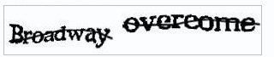
Countermeasures
Use model-based or hybrid algorithms
More robust against profile injection attacks
Accuracy comparable with accuracy of memory-based approaches
Less vulnerable
Increase profile injection costs
Captchas
Low-cost manual insertion …

Slide 18
Countermeasures II
Use statistical attack detection methods
detect groups of users who collaborate to push/nuke items
monitor development of ratings for an item
changes in average rating
changes in rating entropy
time-dependent metrics (bulk ratings)
use machine-learning methods to discriminate real from fake profiles

Slide 19
Privacy aspects
Problem:
Store and manage sensitive customer information
Detailed customer profiles are the basis for market intelligence
Such as segmentation of consumers
Ensuring customer privacy
important for success of a recommender system
users refrain from using the application if privacy leaks get publicly known

Slide 20
Privacy aspects II
Main architectural assumption of CF-Recommender system is
One central server holding the database and
the plain (non-encrypted) ratings are stored in this database
Once an attacker achieved access to that system, all information can be directly used
Prevent such privacy breaches by
Distributing the information or
Avoiding the exchange, transfer or central storage of the raw user ratings.

Slide 21
Data perturbation
Main Idea: obfuscate ratings by applying random data perturbation
Server although does not know the exact values of the customer ratings
Accurate recommendation can still be made because:
The range of data is known
Computation based on aggregation of obfuscated data sets
Tradeoff between degree of obfuscation an accuracy of recommendation
The more "noise" in the data,
the better users' privacy is preserved
the harder the approximation of real data for the server

Slide 22
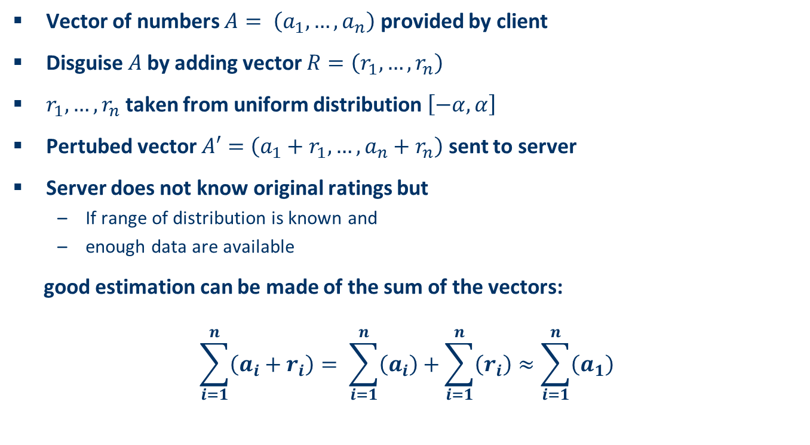
Data perturbation II
Vector of numbers $A= \left(a_{1},…,a_{n}\right)$ provided by client
Disguise $A$by adding vector $R=\left(r_{1},…,r_{n}\right)$
$r_{1},…,r_{n}$ taken from uniform distribution $\left[−α,α\right]$
Pertubed vector $A′=\left(a_{1}+r_{1},…,a_{n}+r_{n}\right)$ sent to server
Server does not know original ratings but
If range of distribution is known and
enough data are available
good estimation can be made of the sum of the vectors:
$$\sum_{i=1}^{n}{\left(a_{i}+r_{i}\right)}= \sum_{i=1}^{n}{\left(a_{i}\right)}+\sum_{i=1}^{n}{\left(r_{i}\right)}≈\sum_{i=1}^{n}{\left(a_{1}\right)}$$

Slide 23
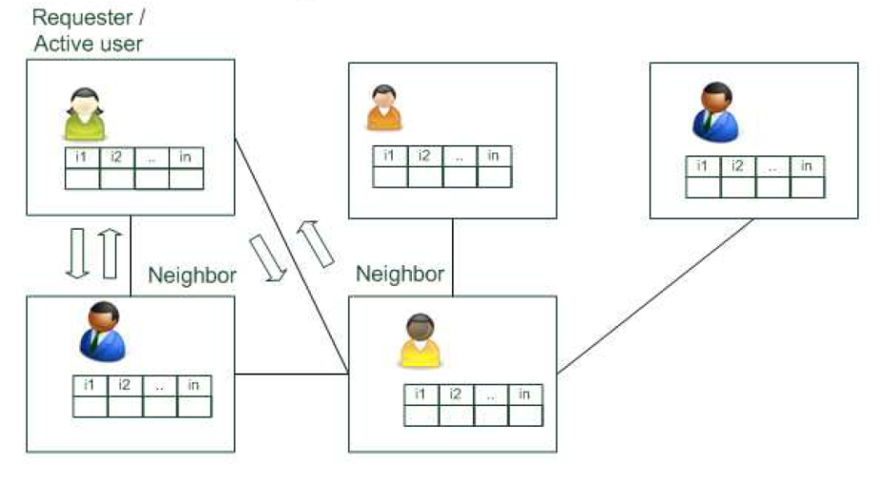
Distributed collaborative filtering
Distribute knowledge and avoid storing the information in one central place
Peer-to-peer (P2P) CF
Exchange rating information in a scalable P2P network
Active user broadcasts a query (vector of user´s item ratings)
Peers calculate similarity between recieved and other known vectors
If similarity > threshold, known ratings returned to requester
If not, query forwarded to the neighboring peers
Activ user calculates prediction with recieved ratings

Slide 24
Distributed collaborative filtering with obfuscation
Combines P2P data exchange and data obfuscation
Instead of broadcasting the "raw" profile only obfuscated version is published
Peers received this broadcast return a prediction for target item
Active user
collects these answers and
calculates a prediction using standard nearest-neighbor-method
Obfuscation will help to preserve privacy of participants
Advisable to perturb only profiles of respondent agents
Obfuscation of requester profile deteriorates recommendation accuracy

Slide 25
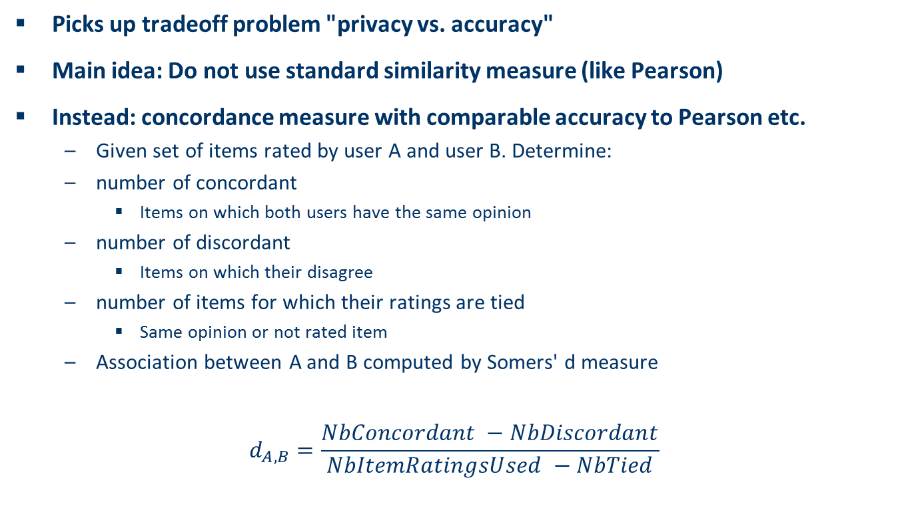
Distributed CF with estimated concordance measures
Picks up tradeoff problem "privacy vs. accuracy"
Main idea: Do not use standard similarity measure (like Pearson)
Instead: concordance measure with comparable accuracy to Pearson etc.
Given set of items rated by user A and user B. Determine:
number of concordant
Items on which both users have the same opinion
number of discordant
Items on which their disagree
number of items for which their ratings are tied
Same opinion or not rated item
Association between A and B computed by Somers' d measure
$$d_{A,B}=\frac{NbConcordant −NbDiscordant}{NbItemRatingsUsed −NbTied}$$

Slide 26
Community-building and aggregates
Participants of knowledge communities share information
inside the community or
with outsiders
Active user can derive predictions from shared information
Informations are aggregated based on e.g. SVD
Individual user ratings are not visible to users outside the community
Use of cryptographic schemes for secure communication between participants in the network

Slide 27
Discussion & summary
Research on attacks
Vulnerability of some existing methods shown
Specially-designed attack models may also exist for up-to-now rather stable methods
Incorporation of more knowledge-sources /hybridization may help
Practical aspects
No public information on large-scale real-world attack available
Attack sizes are still relatively high
More research and industry-collaboration required

